Slide 1
Understanding Communication: From Basics to Modern Innovations
Exploring the evolution and trends in communication
Notes:
AI-generated content may be incorrect. --- Effective communication is crucial in our interconnected world. This presentation will explore the fundamentals of communication, its historical evolution, technological advancements, and interpersonal aspects. We'll also discuss modern communication trends and challenges.

Slide 2
Agenda for Discussion
Fundamentals of Communication
Historical Perspectives on Communication
Technological Advancements in Communication
Interpersonal Communication
Communication in the Modern World
Challenges and Barriers in Communication
Notes:
We will begin with the fundamentals of communication, outlining its definition, elements, and types. Next, we will delve into historical perspectives, discussing ancient methods and the evolution of written language and the printing press. Then, we'll explore technological advancements leading to modern communication forms, followed by interpersonal communication techniques. Finally, we'll address current challenges and barriers in communication.

Slide 3
Fundamentals of Communication
Notes:
Understanding the basics of communication sets the foundation for further exploration. Communication involves transmitting messages, which can be verbal or non-verbal, and is essential for personal and professional interactions.

Slide 4

Definition and Importance
Definition of Communication
Communication involves the exchange of information and meaning between individuals, playing a vital role in interactions.
Importance in Relationships
Effective communication fosters relationships, enabling individuals to connect and build trust with one another.
Facilitating Understanding
Communication facilitates understanding among individuals, helping to clarify ideas and reduce misunderstandings in conversations.
Enabling Collaboration
In various contexts, communication is essential for collaboration, allowing teams to work together towards common goals.
Notes:
Communication is defined as the process of exchanging information and meaning between individuals. Its importance lies in fostering relationships, facilitating understanding, and enabling collaboration across various contexts.

Slide 5
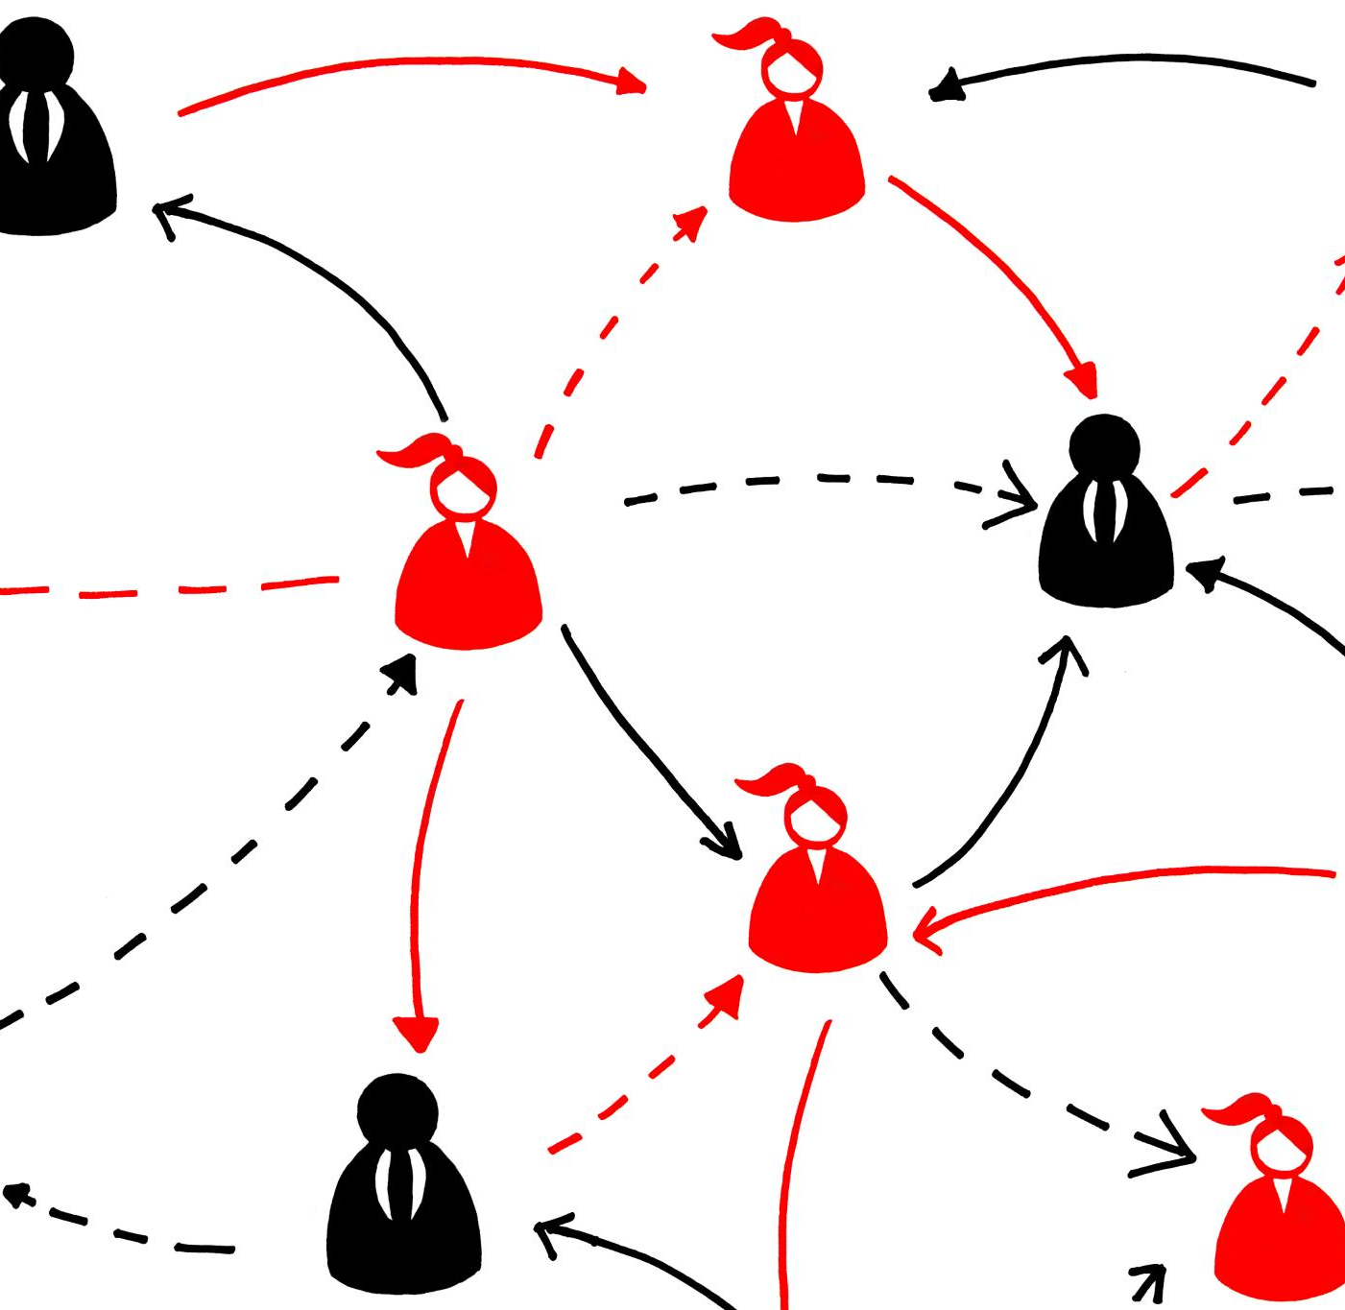
Elements of Communication Process
Sender Role
The sender initiates communication by conveying a message to the receiver. They are crucial for effective communication.
The Message
The message is the information or content being communicated. It should be clear and concise to ensure understanding.
Medium of Communication
The medium is the channel used to deliver the message. This can include spoken words, written text, or digital formats.
Receiver and Feedback
The receiver is the individual who interprets the message. Feedback is essential for confirming understanding and improving communication.
Notes:
The communication process includes key elements: the sender, message, medium, receiver, and feedback. Understanding these components is essential for effective communication, ensuring that messages are delivered and received accurately.

Slide 6
Types of Communication
Verbal Communication
Verbal communication includes both spoken and written forms. It is essential for clear and effective message delivery.
Non-Verbal Communication
Non-verbal communication encompasses body language, gestures, and facial expressions. These cues greatly influence how messages are interpreted.
Role of Communication Types
Both verbal and non-verbal communication types are crucial in conveying messages effectively and influencing perception.
Notes:
Communication can be categorized into verbal (spoken or written) and non-verbal (body language, gestures). Each type plays a vital role in conveying messages and influences how information is interpreted.

Slide 7
Ancient Communication Methods
Oral Traditions
Oral traditions were crucial for passing down stories and knowledge across generations in ancient societies.
Smoke Signals
Smoke signals served as a form of long-distance communication, conveying messages over vast distances in ancient cultures.
Cave Paintings
Cave paintings are one of the earliest forms of visual communication, depicting scenes of daily life and important events.
Notes:
In ancient times, communication methods included oral traditions, smoke signals, and cave paintings. These rudimentary methods laid the groundwork for more sophisticated forms of communication as civilizations developed.

Slide 8

Development of Written Language
Significant Turning Point
The invention of written language transformed communication, enabling societies to document their history and culture.
Documenting History
With written language, societies could preserve their histories and share valuable knowledge for future generations.
Communication Across Distances
Written language allowed for effective communication over long distances, enhancing trade and cultural exchanges.
Notes:
The invention of written language marked a significant turning point in communication. Through scripts and symbols, societies were able to document history, share knowledge, and communicate across distances.

Slide 9

Evolution of Printing Press
Invention of the Printing Press
The printing press was invented in the 15th century, marking a significant milestone in the history of communication.
Mass Production of Texts
The printing press enabled mass production of written materials, allowing for widespread distribution of texts and ideas.
Cultural Impact
This technological advancement revolutionized communication, facilitating the spread of culture and knowledge across Europe and beyond.
Notes:
The invention of the printing press in the 15th century revolutionized communication by mass-producing written materials. This advancement enabled the dissemination of information, ideas, and culture on an unprecedented scale.

Slide 10
Technological Advancements in Communication
Notes:
Technological innovations have transformed communication over the years. From early inventions like the telegraph to the rise of the internet, each advancement has reshaped how we connect with others.

Slide 11
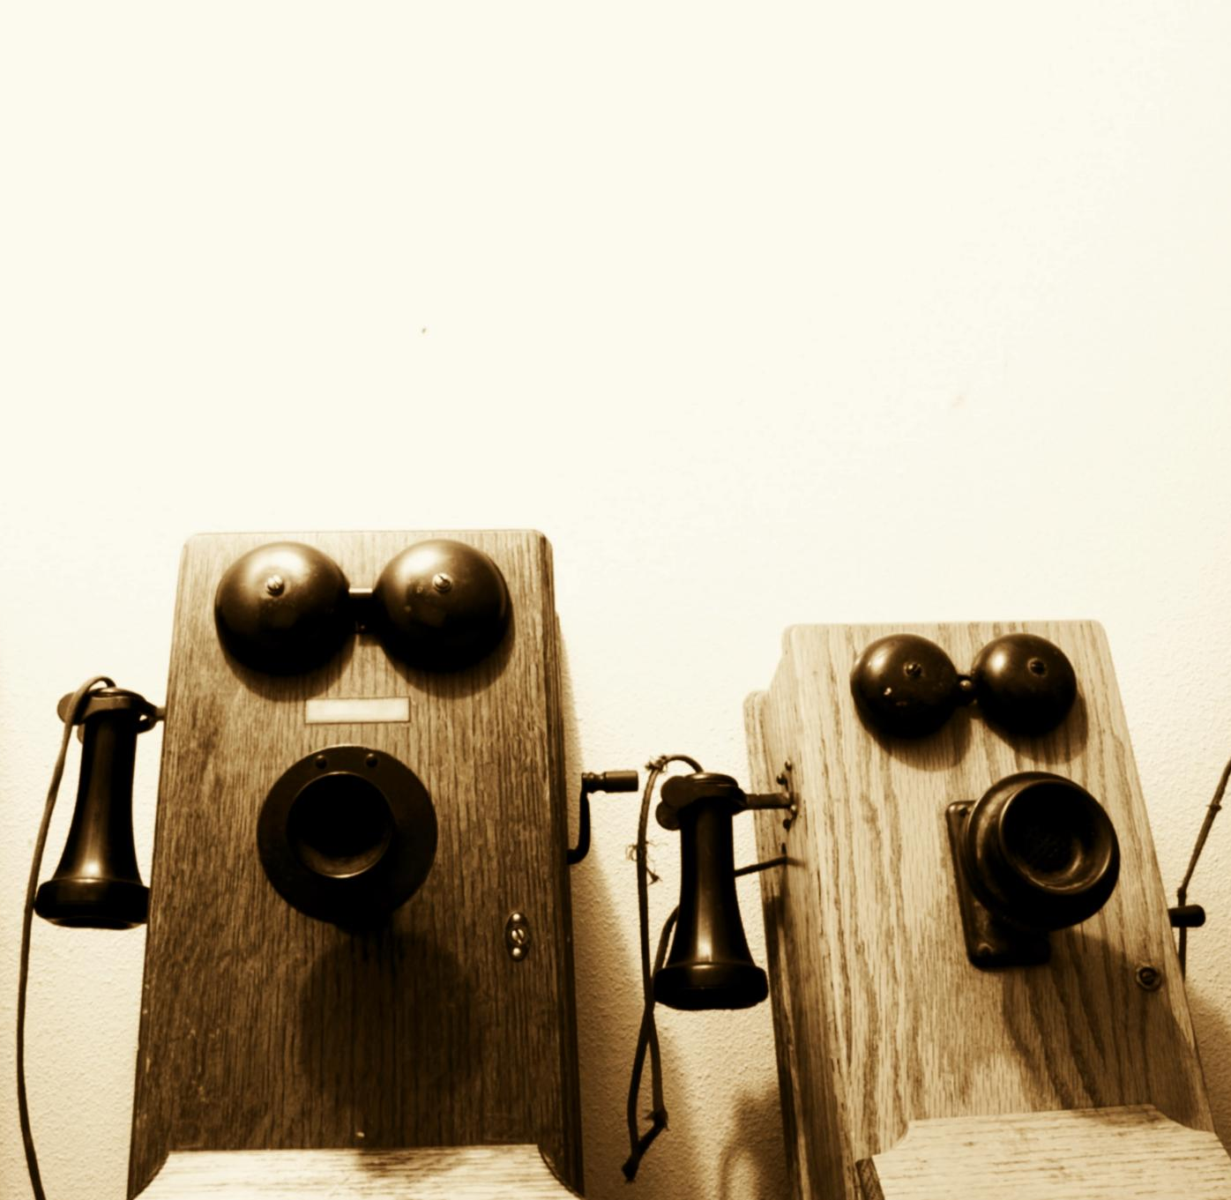
Invention of the Telegraph and Telephone
Groundbreaking Communication
The telegraph and telephone revolutionized long-distance communication, enabling messages to be sent instantly across great distances.
Real-Time Interactions
These inventions facilitated real-time interactions, allowing people to connect and communicate without delays.
Commerce Enhancement
The telegraph and telephone significantly boosted commerce by enabling quick communication between businesses and customers.
Notes:
The telegraph and telephone were groundbreaking inventions that significantly improved long-distance communication. They allowed messages to be transmitted quickly, facilitating real-time interactions and commerce.

Slide 12
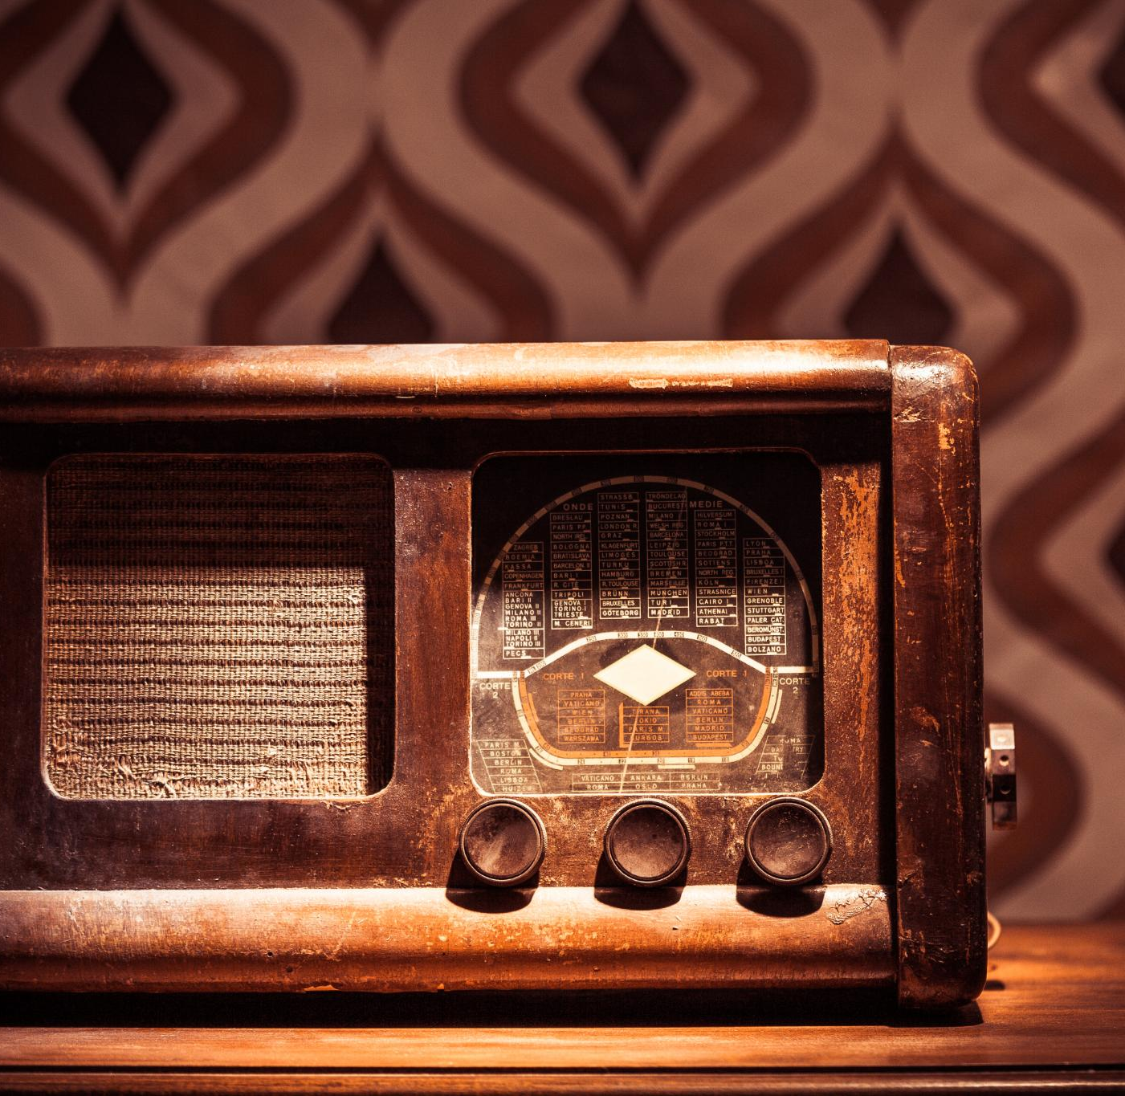
Rise of Radio and Television
New Platforms for Communication
Radio and television emerged as revolutionary platforms that transformed how information is shared with the public.
Broadcasting News and Entertainment
These mediums enabled the broadcasting of news, entertainment, and educational content, reaching diverse audiences worldwide.
Influencing Public Opinion
Radio and television played a crucial role in shaping public opinion, making them powerful tools for social and political influence.
Notes:
The emergence of radio and television created new platforms for mass communication. These mediums allowed for the broadcasting of news, entertainment, and educational content, influencing public opinion on a broad scale.

Slide 13

Digital Revolution and the Internet
Instant Messaging
Instant messaging has revolutionized how we communicate in real time, allowing instantaneous conversations across vast distances.
Social Media Impact
Social media platforms have transformed personal connections and information sharing, creating a global community.
Global Connectivity
The internet has enabled global connectivity, allowing people to interact and collaborate regardless of geographical boundaries.
Notes:
The digital revolution, marked by the advent of the internet, has radically changed communication. It has enabled instant messaging, social media, and global connectivity, transforming how we interact and share information.

Slide 14
Interpersonal Communication
Notes:
Interpersonal communication is vital for building relationships and resolving conflicts. Understanding its components helps enhance personal and professional interactions.

Slide 15

Verbal and Non-Verbal Communication
Importance of Verbal Cues
Verbal communication involves the use of words to convey messages clearly and directly. It is essential for effective dialogue.
Role of Non-Verbal Cues
Non-verbal communication includes body language, facial expressions, and tone of voice, which can enhance or change the meaning of spoken words.
Impact on Perception
The combination of verbal and non-verbal cues can significantly affect how messages are perceived and understood by others.
Notes:
Effective interpersonal communication relies on both verbal and non-verbal cues. While words convey direct messages, body language and tone can significantly alter the perceived meaning.

Slide 16

Effective Listening Skills
Importance of Active Listening
Active listening is crucial for effective communication, enabling deeper understanding and connection between individuals.
Concentration on the Speaker
Fully concentrating on the speaker ensures that the message is understood and valued, fostering better communication.
Thoughtful Responses
Responding thoughtfully to the speaker encourages a respectful dialogue and reinforces understanding.
Notes:
Active listening is fundamental to effective communication. It involves fully concentrating on the speaker, understanding their message, and responding thoughtfully. This skill fosters mutual respect and understanding.

Slide 17

Conflict Resolution and Negotiation
Effective Communication
Effective communication is essential in conflict resolution to address disagreements constructively and promote understanding.
Finding Common Ground
Negotiation skills are vital for finding common ground, which can lead to positive outcomes in various situations.
Positive Outcomes
Fostering positive outcomes through negotiation can improve relationships and facilitate collaboration in both personal and professional contexts.
Notes:
Conflict resolution requires effective communication strategies to address disagreements constructively. Negotiation skills can help find common ground and foster positive outcomes in both personal and professional settings.

Slide 18
Communication in the Modern World
Notes:
Today's world is characterized by rapid communication changes influenced by technology. Understanding these trends is crucial for adapting to new ways of connecting and sharing information.

Slide 19

Social Media and Digital Communication
Transformation of Communication
Social media platforms have revolutionized communication, enabling instant interactions and the rapid sharing of information across the globe.
Misinformation Challenges
Social media introduces challenges such as the spread of misinformation, which can lead to confusion and societal impact.
Privacy Concerns
The use of social media raises significant privacy concerns, as personal data can be easily shared and misused.
Notes:
Social media platforms have transformed how we communicate, allowing for widespread sharing of information and instant interactions. However, they also introduce challenges regarding misinformation and privacy.

Slide 20

Impact of Mobile Technology
Enhanced Communication
Mobile technology allows seamless communication anytime and anywhere, connecting people across the globe instantly.
Revolutionizing Interaction
Smartphones and apps have transformed how we interact, allowing for more dynamic and instant exchanges of information.
Business Transformation
Mobile technology has changed the business landscape, enabling remote work and efficient transaction processes through apps.
Notes:
Mobile technology has enabled communication on-the-go, making it easier to stay connected. Smartphones and apps have revolutionized how we interact, access information, and conduct business.

Slide 21

Future Trends in Communication Technology
Enhanced Connectivity
Future communication technology will prioritize enhanced connectivity, allowing seamless interaction across various platforms.
Artificial Intelligence Integration
Artificial intelligence will play a crucial role in communication, enabling smarter interactions and personalized experiences.
Virtual Reality Experiences
Virtual reality will transform communication by creating immersive experiences that enhance interactions and information sharing.
Notes:
The future of communication technology will likely focus on enhanced connectivity, artificial intelligence, and virtual reality. These advancements promise to further change how we interact and share information.

Slide 22
Challenges and Barriers in Communication
Notes:
Despite advancements, communication challenges persist. Identifying and addressing these barriers is key to improving understanding and collaboration in diverse settings.

Slide 23

Cultural and Language Barriers
Impact of Cultural Differences
Cultural differences can lead to misunderstandings and misinterpretations, affecting communication and relationships.
Language Barriers
Language barriers can complicate conversations and prevent individuals from expressing themselves fully, leading to frustration.
Fostering Inclusion
Understanding and respecting cultural and language differences is vital for creating inclusive environments in communication.
Notes:
Cultural differences and language barriers can hinder effective communication. Understanding and respecting these differences is essential for fostering inclusive interactions.

Slide 24
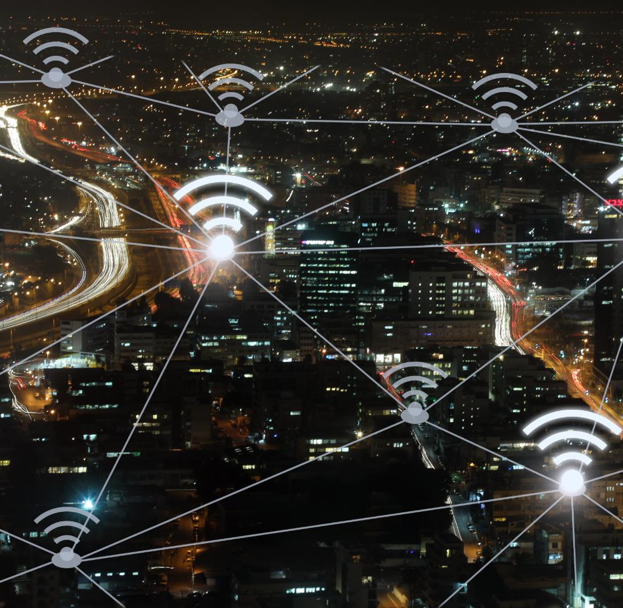
Technological Challenges
Connectivity Problems
Connectivity issues can hinder effective communication and access to digital resources for individuals and communities.
Digital Literacy Gaps
Digital literacy gaps can prevent individuals from fully utilizing technology, impacting their ability to communicate and access information.
Equitable Access
Ensuring equitable access to communication tools is essential for fostering inclusive communication and bridging the digital divide.
Notes:
Technological issues, such as connectivity problems and digital literacy gaps, can impede communication. Addressing these challenges is crucial to ensuring equitable access to communication tools.

Slide 25

Overcoming Communication Obstacles
Empathy in Communication
Empathy plays a crucial role in understanding others' perspectives and emotions, fostering more effective communication.
Active Listening Skills
Active listening involves fully concentrating, understanding, and responding thoughtfully, which helps clear communication barriers.
Adaptability in Dialogue
Adaptability allows individuals to adjust their communication style to better connect with others and overcome misunderstandings.
Notes:
To overcome communication obstacles, individuals and organizations should prioritize empathy, active listening, and adaptability. These skills can bridge gaps and enhance understanding.

Slide 26
Conclusion
Evolution of Communication
Communication has evolved from basic methods to complex forms, adapting to cultural and technological changes over time.
Understanding Fundamentals
Grasping the fundamentals of communication is crucial for enhancing interactions and building stronger relationships.
Modern Communication Challenges
In an increasingly connected world, modern communication faces challenges such as misunderstandings and information overload.
Notes:
Effective communication is a multifaceted skill that has evolved over time. By understanding its fundamentals, historical context, and modern challenges, we can enhance our interactions and foster better relationships in an increasingly connected world.

